Slide 1
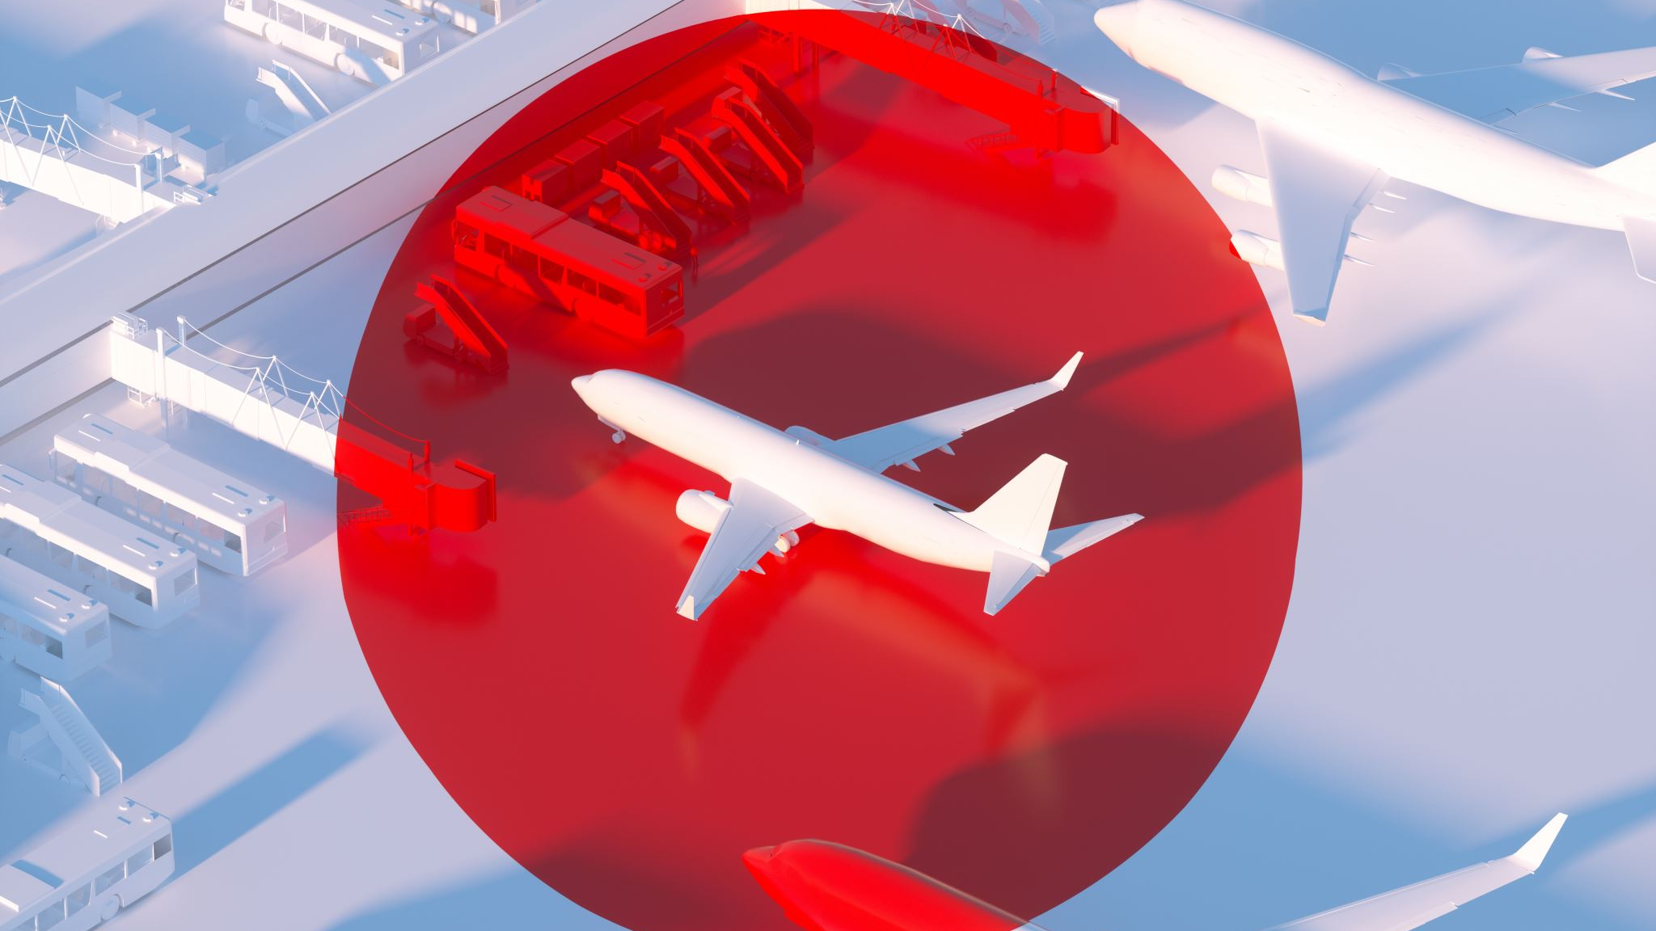
Airline Safety in The News A Review of Recent Trends
Notes:
Greetings, thanks for your time today. My name is Ryan Long, I’m representing the Data Science team here at ABC Airlines. As we’re aware, the topic of airline travel as a concern has been making the rounds in the news cycle lately. The purpose of this discussion is to walk you through an initial review of the recent trends of airline and related modes of transportation safety.

Slide 2

Agenda
Background
Initial Findings
Summary and Next Steps
Notes:
Here is today’s agenda, we’ll be spending most of our time reviewing data visualizations of initial findings and getting your feedback on our proposed next steps.

Slide 3
Background
Problem Statement
Due to recent airline crashes, the media has been promoting statistics stating air is no longer a safe way to travel.
Preliminary Actions Taken
Initial efforts have centered on a data focused review of historical trends of airline and motor vehicle incidents, measurement of activities, and popularity of search terms from a geographical perspective. Supplementary metrics on the airline industry from regulatory bodies have been included for future consideration to mitigate media reports.
Summary of areas reviewed
Recent and historical airline and motor vehicle fatalities and injuries
Airline and motor vehicle usage
Search trends for airline safety by region
Recent sales airline sales
Notes:
[Speak to the slide – read/paraphrase]

Slide 4
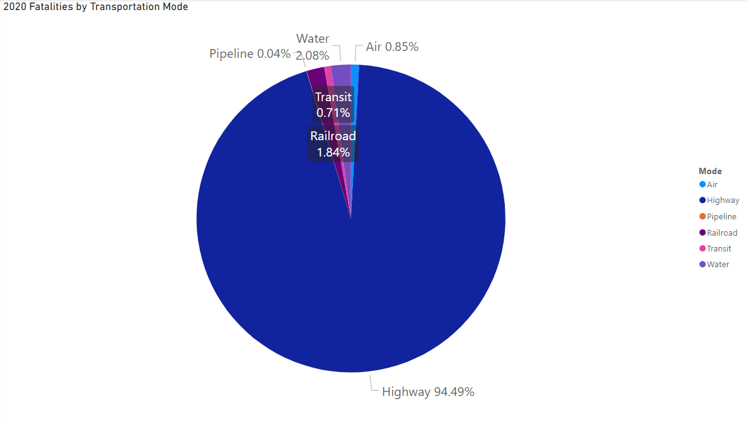
Initial Findings: 2020 Travel Fatalities
Notes:
This data comes to us from the Bureau of Transportation Statistics and summarizes fatalities by major mode of transportation in 2020. As can be seen, highway transportation contributes most of the deaths, while airline and other categories are immaterial. We’ll use motor vehicle travel as a comparison to airline travel in the following slides.

Slide 5
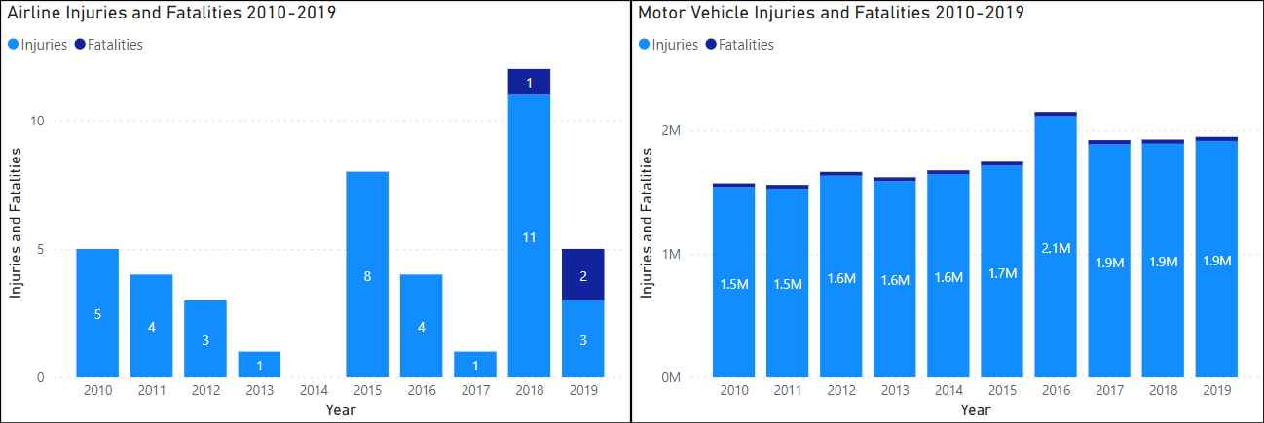
Initial Findings Continued: Injuries and Fatalities
Notes:
First up is our research on the injuries and fatalities of both Airline and Motor Vehicle transportation.
From a historical perspective it is clear, airline travel has had far fewer injuries and fatalities per year compared to motor vehicle travel. While the phrase, ‘past performance is not an indicator of future returns’ in the investing world rings out, we should not shy away from presenting this stellar record of a relatively non-existent safety threat. The strategy should help us re-frame the current media blitz with stakeholders and how it should not be a material concern moving forward if we can show has changed.

Slide 6
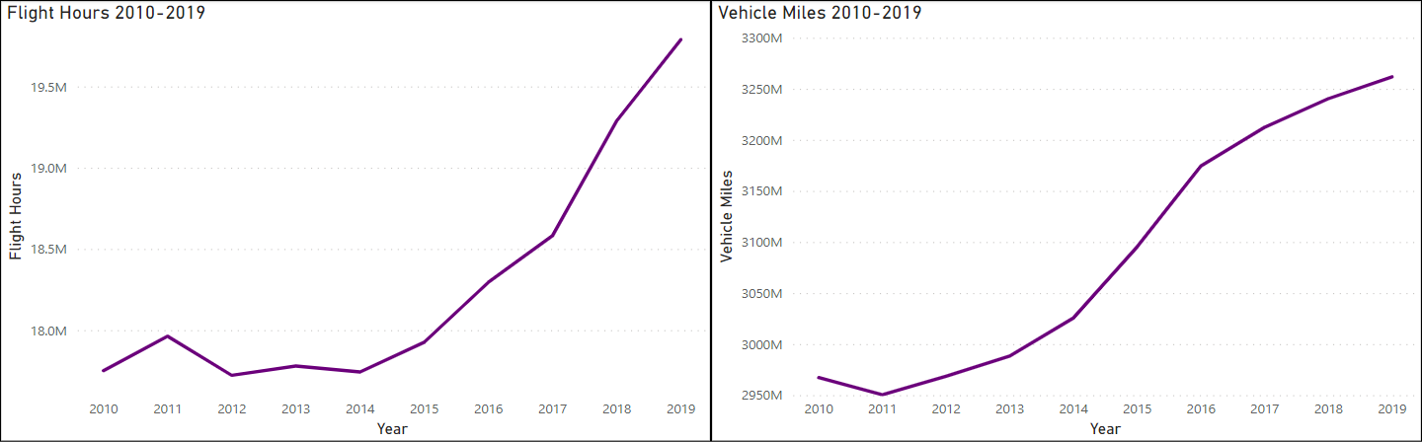
Initial Findings Continued: Flight Hours and Miles
Notes:
This second set of graphs display the volume of flight hours and vehicle miles over the 10-year period 2010-2019. This is the same period displayed on the prior slide. The trends indicate an upward increase in both methods of transportation. The challenge here is the comparison between the two as the units of measurement are materially different. The data team had significant debate between converting either measure hours or miles to one or the other, however subjective assumptions would need to be made, such as average miles in a flight hour.
The purpose here is to gain a baseline understanding of how much of each mode of transportation is being used. We can see there is a significant increase in airline travel starting in 2014 through 2019, while referring to the previous slide, there is not a corresponding rise in injuries or fatalities. Vehicle miles also increases in the time period, but from 2011 through 2019, but not as sharply. Referring again to the prior slide, there is a general rise in injuries and fatalities.

Slide 7
Initial Findings Continued: Simple Stats
2019
Airline Travel |  | Motor Travel
Fatality Rate | Injury Rate | Fatality Rate | Injury Rate
0.00001% | 0.00002% | 0.00102% | 0.05875%
Fatality per | Injury per | Fatality per | Injury per
9,894,206 | 6,596,137 | 98,116 | 1,702
hours flown | hours flown | miles driven | miles driven
1 Fatality per | 1 Injury per
1,635 | 28
hours driven* | hours drive*
* Assumes avg speed of 60mph
Notes:
Using the latest complete year we have detailed information for, this table shows a comparison between the both the percentage of fatalities and injuries for both modes of travel. While the percentages are extremely low, generally understanding is enhanced when expressed in the units of measurement. Given their unique measurements, airline travel can still be shown to be a safer mode of transportation. If we were to publish this information a recommendation would be to normalize the two units of measurement. We would likely convert miles driven to hours, using 60mph. If disclosed through a footnote the data team would feel comfortable. This proposed conversion can be seen in the floating lower blue table.

Slide 8
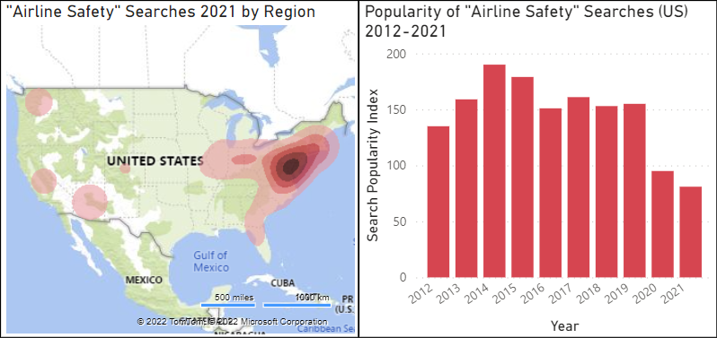
Initial Findings Continued: Search Term Review
Notes:
This next set of visualizations takes a more recent perspective as the data is taken directly from Google’s search terms.
The purpose of the regional heatmap is to understand whether the concern related to airline safety has a regional basis and whether any of our hubs could be impacted. As we can see, there is a predominantly east coast origin for the search term. The West coast is not as materially relevant, but there are concerned searchers in Washington, California, and Arizona. Colorado is barely a blip.
Next is the summation of Google’s popularity index for the search term. This graph shows a decline in the search term, so makes one question the media’s effort towards spotlighting airline safety.

Slide 9
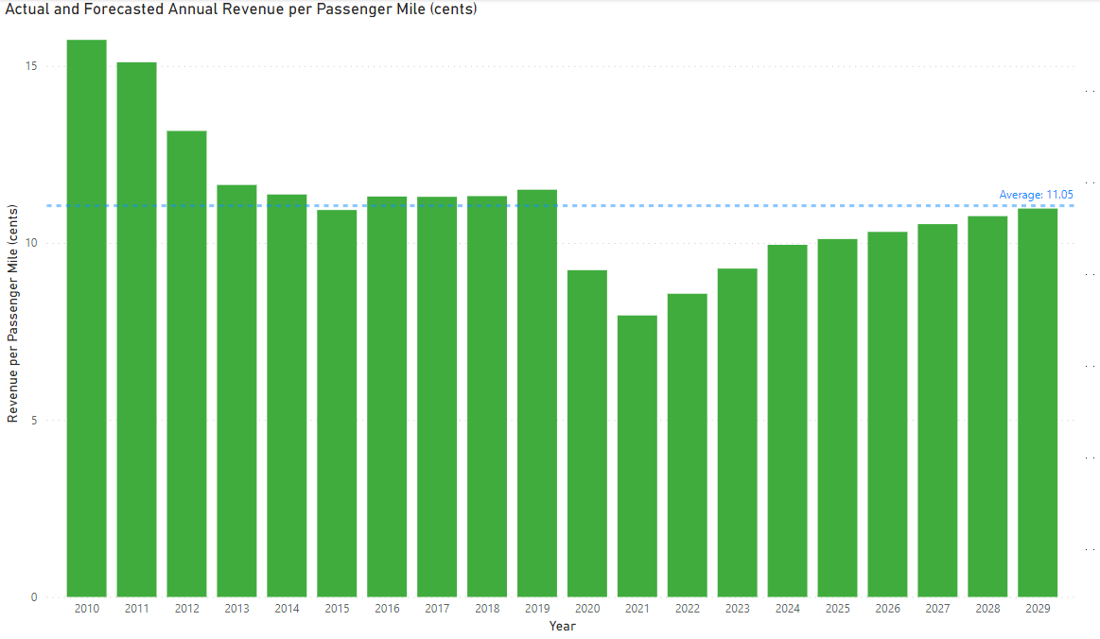
Initial Findings Continued: Revenue Forecast
Notes:
This information comes to us from the FAA’s forecast and depicts actual and forecasted revenue per passenger mile for the period 2010 through 2029. As can be see, the industry has been impacted significantly in 2020 and will slowly recover but not until 2029. That is why it is important for ABC airlines to differentiate itself from the safety concerns expressed in the recent media cycle. More on that in our next steps proposal.

Slide 10
Summary and Next Steps
Summary
Air travel has been safer than motor vehicle travel
More concern with airline safety on the US East coast, but searches for ‘airline safety’ have declined
The airline industry has experienced a decline in revenue with a forecasted slow recovery
Next Steps: Initiate a Multimedia Campaign emphasizing:
Historical track record of safety
The current statistics and rarity of incidents
Differentiate Airline travel from Motor vehicle
Notes:
We have discussed how safe airline travel is, how rate or unlikely fatalities and injuries are to occur. Additionally, when compared to the other primary mode of transportation it is much safer. We know of the significant decline and slow recovery on revenue per passenger mile. What we propose is initiating a multimedia campaign with a facts and data-based approach. This campaign would utilize various media channels emphasizing the safety of airline travel using various visualizations which are easy for stakeholder to digest yet provide the positive impact we desire.
Thank you for your time today and we look forward to your feedback.

Slide 11
Appendix – Data Sources
Slide 4
https://www.bts.gov/content/transportation-fatalities-mode
Slide 5 & 6
https://www.ntsb.gov/safety/Pages/research.aspx
https://www.ntsb.gov/safety/data/Pages/AviationDataStats2019.aspx
https://www-fars.nhtsa.dot.gov/Main/index.aspx
https://www.fhwa.dot.gov/policyinformation/travel_monitoring/tvt.cfm?CFID=210588508&CFTOKEN=738ef6d3a5c44efd-E63E30CD-BD2A-5E9A-7A89791FCE1CE6FB
Slide 7
Calculations utilizing slide 4 & 5 sources
Slide 8
https://trends.google.com/trends/explore?date=2005-01-01%202022-01-01&geo=US&q=airline%20safety
Slide 9
https://www.faa.gov/data_research/aviation/aerospace_forecasts/

